Slide 1
LESSON 23

Slide 2
Overview
of
Previous Lesson(s)

Slide 3
Over View
LR(k) parsing
L is for left-to-right scanning of the input.
R is for constructing a rightmost derivation in reverse.
(k) represents the number of input symbols of look-ahead that are used in making parsing decisions.
When (k) is omitted, k is assumed to be 1

Slide 4
Over View..
To construct the canonical LR(0) collection for a grammar, we define an augmented grammar and two functions, CLOSURE and GOTO
If G is a grammar with start symbol S, then G', the augmented grammar for G, is G with a new start symbol S' and production S' → S
The purpose of this new starting production is to indicate to the parser when it should stop parsing and announce acceptance of the input. That is, acceptance occurs when the parser is about to reduce by S' → S

Slide 5
Over View…
Closure of Item Sets
If I is a set of items for a grammar G, then CLOSURE(I) is the set of items constructed from I by the two rules:
Initially, add every item in I to CLOSURE(I)
If A → α·Bβ is in CLOSURE(I) and B → γ is a production, then add the item B → .γ to CLOSURE(I) if it is not already there. Apply this rule until no more new items can be added to CLOSURE(I)

Slide 6
Over View…
The Function GOTO
The second useful function is GOTO(I,X) where I is a set of items & X is a grammar symbol.
GOTO(I,X) is defined to be the closure of the set of all items [A → αX∙β] such that [A → α∙Xβ] is in I
Intuitively, the GOTO function is used to define the transitions in the LR(0) automaton for a grammar.
The states of the automaton correspond to sets of items, & GOTO(I,X) specifies the transition from the state for I under input X

Slide 7
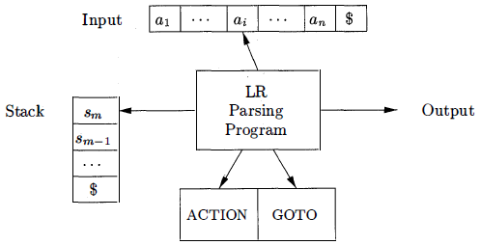
Over View…
LR parser
It consists of an input an output a stack a parsing program & a parsing table that has two parts (ACTION and GOTO)

Slide 8
Over View…
Structure of the LR Parsing Table
It consists of two parts: a parsing-action function ACTION and a goto function GOTO.
Given a state i and a terminal a or the end-marker $ ACTION[i,a] can be
Shift j The terminal a is shifted on to the stack and the parser enters state j.
Reduce A → α The parser reduces α on the TOS to A.
Accept
Error

Slide 9
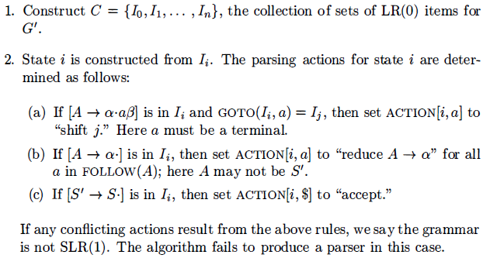
Over View…
SLR Parsing Table
The SLR method begins with LR(0) items and LR(0) automata.
INPUT: An augmented grammar G‘
OUTPUT: The SLR-parsing table functions ACTION and GOTO for G’
METHOD:

Slide 10
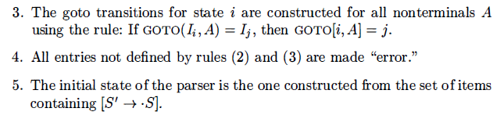
Over View…
Ex: Now we construct the SLR table for the augmented expression grammar.
The canonical collection of sets of LR(0) items for the grammar are the same as we saw in last lesson.

Slide 11
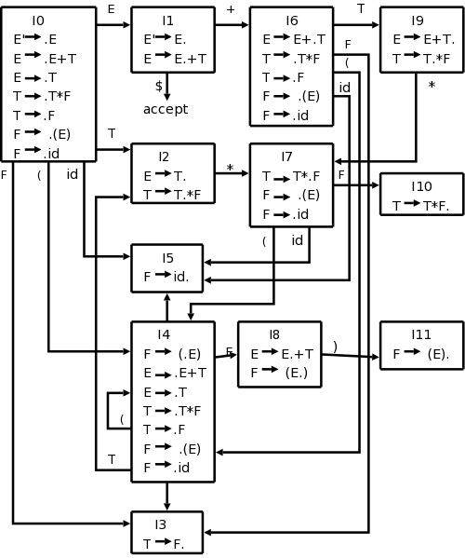
Over View…
First consider the set of items I₀ :
E‘ → ∙E
E → ∙E + T | ∙T
T → ∙T * F | ∙F
F → ∙(E) | ∙id
The item F → ∙(E) gives rise to the entry ACTION[0,(] = shift 4
The item F → ∙id to the entry ACTION [0,id] = shift 5
Other items in I₀ yield no actions.

Slide 12
Over View…
Now consider I₁
E‘ → ∙E
E → E∙ + T
The 1st item yields ACTION[1,$] = accept
The 2nd item yields ACTION[1,+] = shift 6
For I₂
E → T∙
T → T∙ * F
Since FOLLOW(E) = {$, +, )} the 1st item yields ACTION[2,$] = ACTION[2,+] = ACTION[2,)] = reduce E → T
2nd item yields ACTION[2,*] = shift 7
Continuing in this fashion we obtain the ACTION and GOTO tables

Slide 13
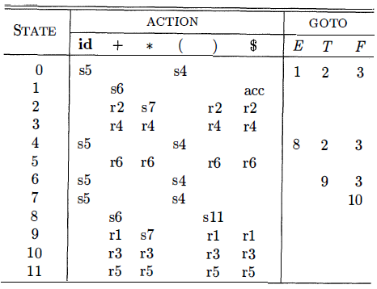
Over View…
Parsing table for the Ex Grammar G
Grammar G
E → E + T 4. T → F
E → T 5. F → ( E )
T → T * F 6. F → id

Slide 14
TODAY’S LESSON

Slide 15
Contents
Introduction to LR Parsing
Why LR Parsers?
Items and the LR(0) Automaton
The LR-Parsing Algorithm
Constructing SLR-Parsing Tables
Viable Prefixes
Powerful LR Parsers
Canonical LR(1) Items
Constructing LR(1) Sets of Items
Canonical LR(1) Parsing Tables
Constructing LALR Parsing Tables
Efficient Construction of LALR Parsing Tables
Compaction of LR Parsing Tables

Slide 16
Viable Prefixes
The prefixes of right sentential forms that can appear on the stack of a shift-reduce parser are called viable prefixes
The LR(0) automaton for a grammar characterizes the strings of grammar symbols that can appear on the stack of a shift-reduce parser for the grammar.
The stack contents must be a prefix of a right-sentential form.
If the stack holds α and the rest of the input is x then a sequence of reductions will take S ⇒*_{rm} αx

Slide 17
Viable Prefixes..
A viable prefix is a prefix of a right-sentential form that does not continue past the right end of the rightmost handle of that sentential form.
By this definition, it is always possible to add terminal symbols to the end of a viable prefix to obtain a right-sentential form.
SLR parsing is based on the fact that LR(0) automata recognize viable prefixes.

Slide 18
Powerful LR Parsers
Now we shall extend the previous LR parsing techniques to use one symbol of look-ahead on the input.
Two different methods:
The "canonical-LR" or just "LR" method, which makes full use of the look-ahead symbol(s) . This method uses a large set of items, called the LR(1) items.
The "look-ahead-LR" or "LALR" method, which is based on the LR(0) sets of items, and has many fewer states than typical parsers based on the LR(1) items.

Slide 19
Canonical LR(1) Items
SLR used the LR(0) items that is the items used were productions with an embedded dot, but contained no other (look-ahead) information.
The LR(1) items contain the same productions with embedded dots, but add a second component, which is a terminal (or $).
This second component becomes important only when the dot is at the extreme right (indicating that a reduction can be made if the input symbol is in the appropriate FOLLOW set).

Slide 20
Canonical LR(1) Items..
For LR(1) we do that reduction only if the input symbol is exactly the second component of the item. This finer control of when to perform reductions, enables the parsing of a larger class of languages.
Formally, we say LR(1) item [A → α∙β , α] is valid for a viable prefix ϒ if there is a derivation S ⇒*_{rm} δAw ⇒_{rm} δαβw where
ϒ = δα
Either a is the first symbol of w, or w is ɛ and a is $ .

Slide 21
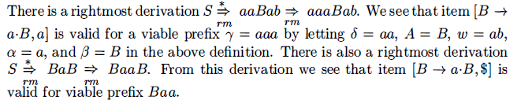
Canonical LR(1) Items…
Ex
S → B B
B → a B | b

Slide 22
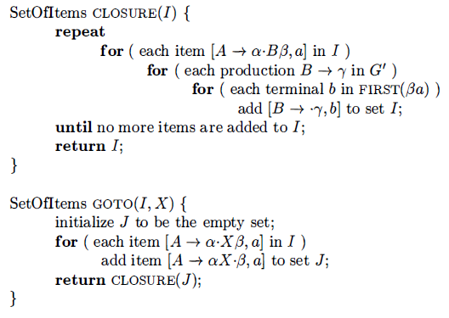
Constructing LR(1) Items
The method for building the collection of sets of valid LR(1) items is the same as the one for building the canonical collection of sets of LR(0) items.
We need only to modify the two procedures CLOSURE and GOTO

Slide 23
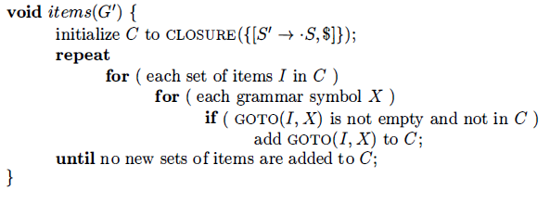
Constructing LR(1) Items..
Sets-of-LR(1)-items construction for grammar G‘

Slide 24
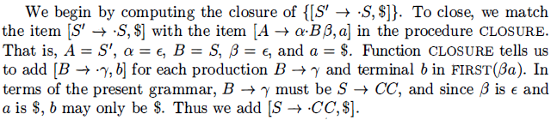
Constructing LR(1) Items...
Ex: Consider the following Augmented Grammar:
S’ → S
S → C C
C → c C | d

Slide 25
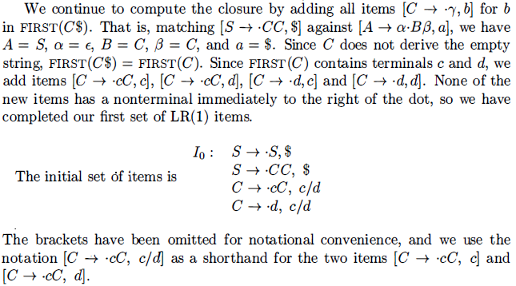
Constructing LR(1) Items…

Slide 26
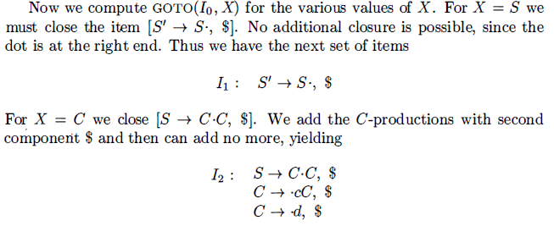
Constructing LR(1) Items…

Slide 27
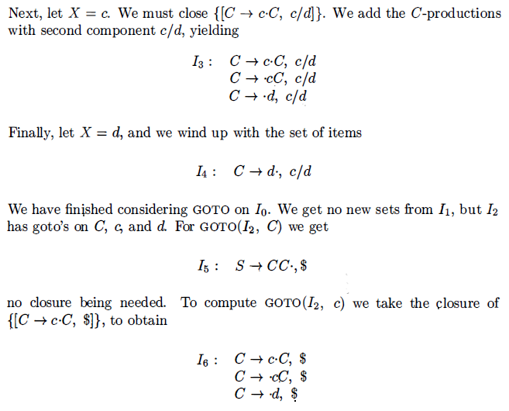
Constructing LR(1) Items…

Slide 28
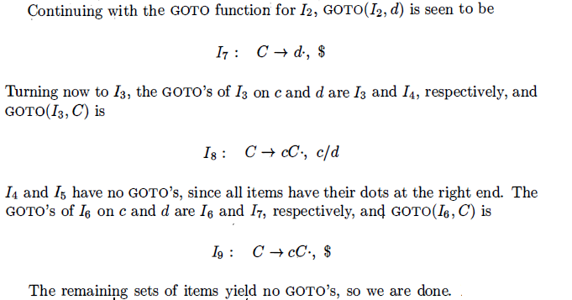
Constructing LR(1) Items…

Slide 29
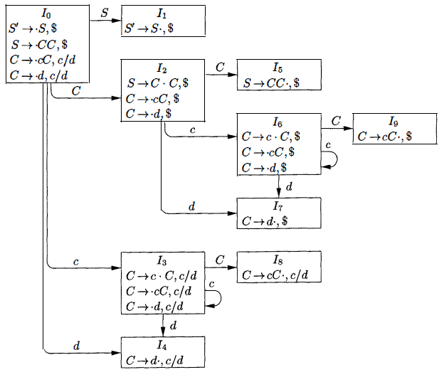
Constructing LR(1) Items…

Slide 30
Canonical LR(1) Parsing Tables
Rules for constructing the LR(1) ACTION and GOTO functions from the sets of LR(l) items.
These functions are represented by a table, as before.
The only difference is in the values of the entries.
INPUT: An Augmented Grammar G’
OUTPUT: The canonical-LR parsing table functions ACTION and GOTO for Augmented Grammar G’

Slide 31
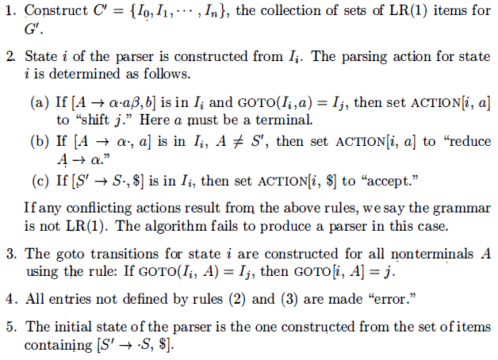
Canonical LR(1) Parsing Tables..
METHOD:

Slide 32
Constructing LR(1) Items…
S’ → S
S → C C
C → c C
C → d

Slide 33
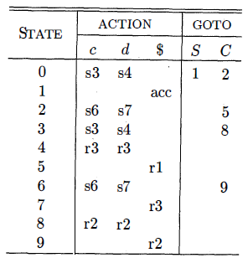
Canonical LR(1) Parsing Tables...
For Grammar G’
S’ → S
S → C C
C → c C
C → d
Canonical parsing table is

Slide 34
Thank You

